Slide 1
Economic History of Bengal Agriculture, Industry, Trade and Famine
Muhammad Asiful Basar (Mab2)
Lecturer
Department of History and Philosophy
North South University

Slide 2
Introduction
The economic life and activities of the people of Bengal since to the formation of Janapads till the beginning colonial rule, seem to be more attractive than any other aspect of its history. Politically Bengal was rarely fortunate to manage its freedom from foreign subjugation, and culturally never free from the external influences. Brahminism, Buddhism, Islam, and cultures of all invading people, who ruled this region sometime or other had always influenced the habits, customs, manners, prejudices and thoughts of its people. It was only in the sphere of economic life that the Bengal people had always been original in their thought and activities and they had continued to play their role autonomously until they were subjugated by the British.

Slide 3
The name of Bengal muslin and its other manufactures became well-known to the whole of the maritime world from the times of Pliny. It is to be noted that Bengal was known to the outside world not by any general, not by any ruling dynasty like the Palas or Senas or Pathans but by its humble artisan class whose products created demand from far and wide. Artistically and technologically, if the Bengal manufactures had any unique feature or features unaffected by foreign influence it was because of the independent operations of the artisans.
Based on availability of data and sources this lecture will split the Bengal Economic history in two parts:
Pre-colonial Bengal Economy
Colonial Bengal Economy

Slide 4
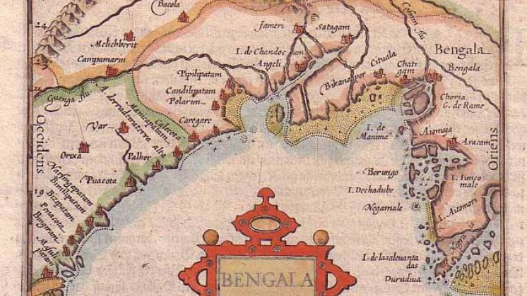
Pre-colonial Bengal Economy
“Sonar Bangla”is the word that we traditionally use to describe the prosperity of Bengal economy during the ancient and medieval time. Fertile delta of Bengal attracted people from all directions. During the ancient time the wealth generation in Bengal’s economy developed significantly. At the same time industrial raw material production and extracting minerals from nature also emerged significantly. Trade with the world made Bengal one of the wealthiest countries of the world.

Slide 5
The main sectors of Bengal’s economy during the Pre-colonial time are:
Agriculture
Trade and Commerce
Manufacturing Industries, like textile and ship building
Production and exportation of Industrial raw materials
Extraction of natural minerals etc.

Slide 6
a. Agriculture
The beginnings of agriculture in Bengal, have to be traced back to the pre-historic past. Foundations of civilization as well as village life-based Agricultural economy had been laid by Nishadas or Austric speaking people. The Austric Tribes brought with them a primitive system of Agriculture producing a varieties of products. These Austric speaking people developed a large water transportation system, initially using long boat called Donga. These, in turn, laid the foundation of wealth generation through trade. In the initial stage the growth of population and settlement of other groups, agriculture followed a more diverse and complex course depending on the great river-systems of the delta, which acted as powerful fertilizing agents of its soil. During the pre-historic time, it is assumed that most of the Bengal land was covered by either forest or water bodies.

Slide 7
There is no doubt that by the 7th century A.D. the majority of the people had taken agriculture as the chief means of livelihood. The Chinese pilgrim Hiuen Tsang bears testimony to the fact that in all parts of the province the countryside was regularly and assiduously cultivated, and produced grains, flowers and fruits in abundance.
The copper-plate inscriptions ranging from the 8th to the 13th century, which we discovered from many places around Bengal, mention the cultivators as Kshetra-karah or Karshakali, as an important class apart from the officials, Brahmanas and others, and in various ways convey an idea of the important role they played in the economic life of the community.

Slide 8
Based on the information of various sources, it can be said that paddy (dhanya) was cultivated from a remote antiquity as the staple food-crop of the people. The Mahasthan Brahml inscription probably refers to a rice granary located at Pudanagala (Pundranagara).The Ramacharita mentions "paddy plants of various kinds" grown in Varendri. The inscriptions of the Sena kings mention "smooth fields growing excellent paddy,” and" numbers of villages, consisting of land growing paddy in excessive quantities."
Another food-crop cultivated was probably sugar-cane. A Greek author, Aelian, speaks of a kind of honey expressed from reeds which grew among the Prasioi.

Slide 9
Another author Lucan says that the Indians near the Ganges used to drink sweet juices from tender reeds. Susruta mentions a variety of sugar-cane called Paundraka which was grown in the Paundra country
The other records mention a variety of other crops, especially spices grown in different parts of Bengal. These include Malabathrum (Tejpata) and Spikenard (Nishandhi), mentioned in the Periplus of the Erythraean Sea among the exports of this province. These were obviously of excellent quality, and were grown on an extensive scale in the Eastern Himalayas. Another cultivated crop appears to have been mustard.

Slide 10
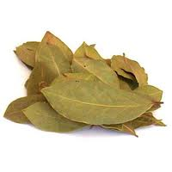
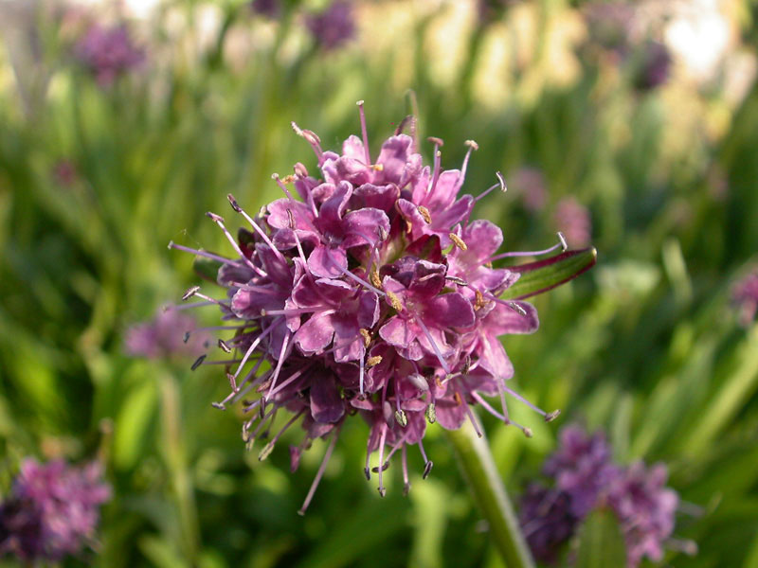

Malabathrum
Spikenard
Betel-vines

Slide 11
Further, epigraphic records tell us that betel-nut palm (guvaka) and cocoanut (Narikela) were extensively grown. Betel-vines were also cultivated in the form of plantations and formed, under the Sena kings, a source of revenue to the state. Cotton was also cultivated to feed an important industry of the province. Kautilya mentions finest quality karpasika or cotton fabrics manufactured in Vanga.
According to the inscription of Vijayasena, ordinary rural folk were familiar with seeds of cotton. The early Charyapadas also refer to cotton cultivation. Referring to the people of Bengal, Marco Polo says, "They grow cotton, in which they derive a great-trade”. Fruits like Mango, bread-fruit (panasa), pomgranate (dalimya), bassia latifolia ( mahua ), date ( kharjura ), citron ( vija ) and figs ( Dumur ) were also widely cultivated.

Slide 12
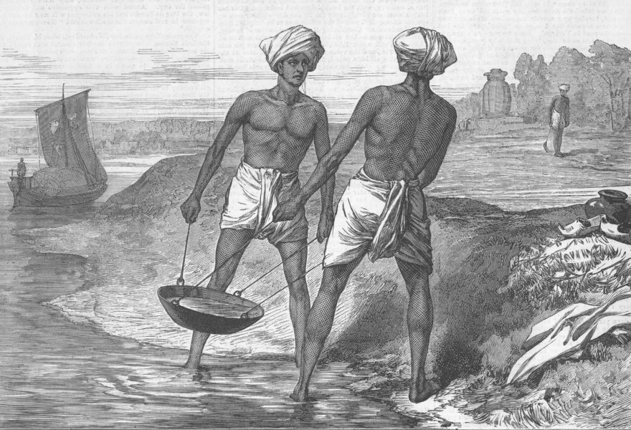
Niccollao Manouchi the Italian physician of Aurangjeb, wrote: “Bengal’s huge wealth, which flows to Europe, is a proof of this country’s fertility. In fact the productivity of this country in silk, cotton, sugar and indigo surpassed Egypt. Everything is in plenty here. Here there is plenty of fruits, food grain, Muslin, golden textile and silk”.
Factors that Contributed to the Growth of Agriculture in Bengal:
Abundance of Water
Very fertile and alluvial soil
Long Monsoon Season
Annual Fresh Flood
Favorable tropical temperature
A hard working Peasant class

Slide 13
Growth of Crafts and Industries in Bengal
Historically Bengal played a major role in the development of trade and commerce in the Bay of Bengal region. Fame of Textiles of Bengal Muslin, spread all over the world long before B.C. In fact Mummy has been found wrapped with Muslin dated 2000 B.C. in Egypt. Chinese traveler Chao-Ju-Kua Ping stated about Kalo of Bengal, that excellent swords were made there as well as cotton and other textiles.
The most note worthy among the crafts and Industries were Textiles, Sugar, Metal work, Stonework, Wood work and Pottery.
Textile Manufacture
There were four varieties of textile commodity which were produced in Bengal. These were Kshauma, Dukula Patrorna and Karpasika. Kshauma was linen but of a coarse variety, being mixed with cotton.

Slide 14
Its chief seats of manufacture were Pundravardhana (North Bengal) and Benares. A pure and finer form of linen was called Dukula. Patrorna appears to have been wild silk. Historical sources say that it was a fiber produced by the saliva of a worm "on the" leaves of certain trees: and Pundra produced abandoned the majority of this wild silk.” It should be noted that wild silk of the best quality is still produced in these districts.
Karpasika obviously meant cotton fabrics. These were manufactured in various parts of India, but Vanga and other regions, as Kautilya affirms, produced the best quality. It is thus evident that as early as the time of Kautilya Bengal had attained to great eminence as a seat of textile manufacture.

Slide 15
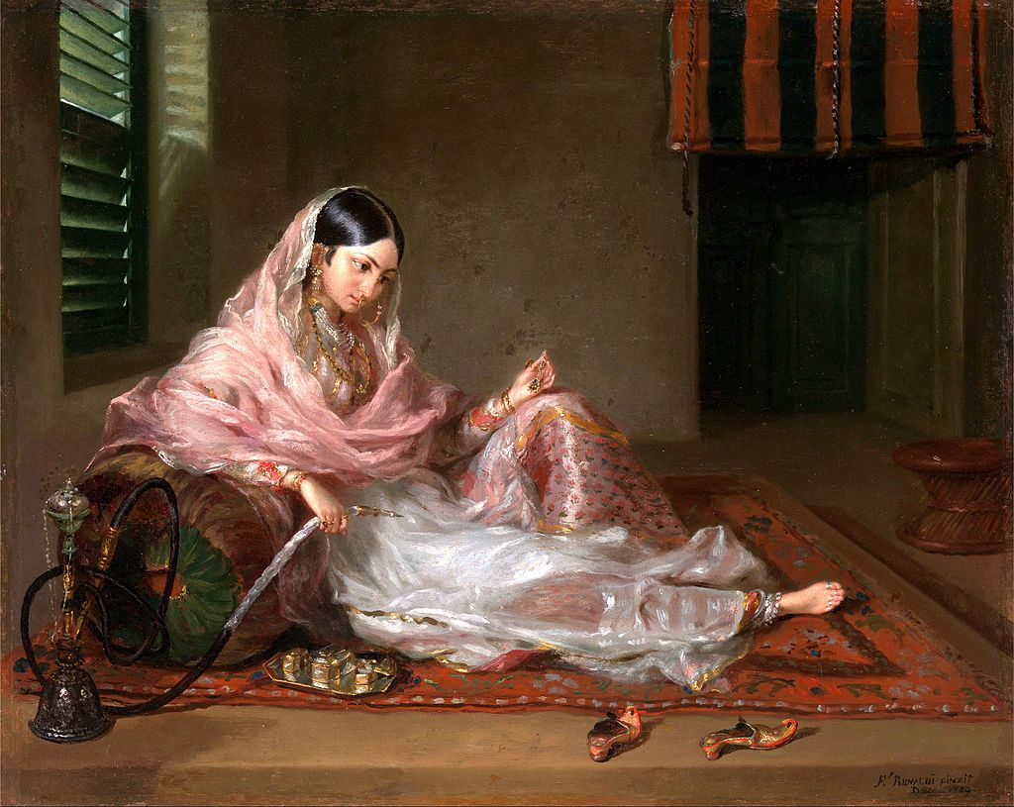

Slide 16
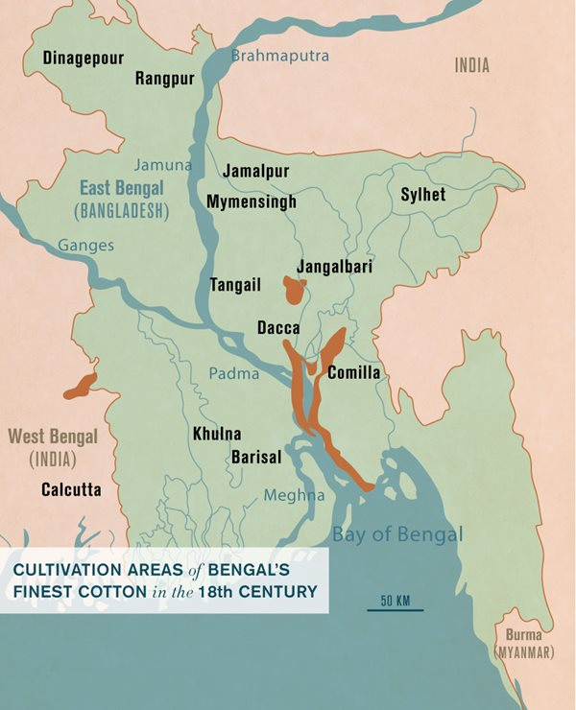

Slide 17
It may be noted that- the Periplus of the Erythraean Sea, written in the 1st century A.D., includes "muslins of the finest sorts" among the exports of Bengal. Referring to Ruhml, the Arab merchant Sulaiman wrote in the 9th century A.D. that there was "a stuff made in this country which is not to be found elsewhere; so fine and delicate is this material that a dress made of it was 3 feet in breadth and about 29 feet in length and may be passed through, a signet-ring.' Sulaiman added that it was made of cotton, and that he was not speaking from hearsay, but had himself seen a piece of it. In the fifteenth century Ma Huan, the Chinese traveller, witnessed five or six varieties of textile goods being manufactured in Bengal.

Slide 18
Sugar and Salt
Another industry which seems to have made considerable headway was sugar. Bengal was probably one of the earliest homes of sugar-cane cultivation. Susruta mentions that the Paundraka cane (which grew in the Paundra country) were noted for the large quantity of sugar which they yielded. In the thirteenth century Marco Polo noticed that sugar juice was one of the important commodities of export from Bengal. Early in the sixteenth century the Portuguese traveller, Barbosa, found Bengal competing with South India in the supply of sugar to different parts of India. Ceylon, Arabia and Persia.

Slide 19
The manufacture of salt by means of evaporation either from infiltrated sea-water or from subsoil brine was also probably known and practiced in certain areas. The manufacture of salt was known and practiced in certain places, however, it had not developed into any, considerable industry. The dampness of the climate and the large amount of fresh water discharged into the sea by the Ganges and the Brahmaputra might have, hampered the growth of any large-scale salt manufacture.

Slide 20
Jewelry, Stone and Wood works
Jewelry making was another profitable industry where a considerable group of metal-workers were involved. The jewelry was the fashion of the rich and they had practices to use gold and silver dishes and ornaments made of pearls and precious stones and metals for personal adornment. The Deopara inscription of Vijayasena mentions "flowers made of precious stones, necklaces, ear-rings, anklets, garlands and golden bracelets," worn by the wives of the king's servants’’.
Two other categories of craftsmen were the workers in stone and wood. The numerous pre-Muslim stone images discovered in Bengal and the beautifully engraved inscriptions on stone slabs bear eloquent testimony both to the volume and skill of the stone-carvers' profession.

Slide 21
International Trade of Bengal Before British Colon
Living standard of Bengal started improving from the middle of 1st century. The land of Bengal was turned into a golden land from 4th and 5th Century. The main reason was the development of sea trade. Even before that the country had a business relationship with eastern Mediterranean countries. But the trade was mainly in the hands of the Arabs. From 50 A.D. India and Rome got into direct contact. Gold continued to flow into India from Rome. Pliny stated if the flow of gold continues to be like this then there will be no gold left in Roman Empire. However, Trade with Rome started to decline since 475 A.D. through to half of 7th century. Since the advent of Islam Arab trade started to rise from 606-7 A.D.

Slide 22
The Devastation of the Economy of Bengal by British Colonialism
Industrial revolution in England led to mass production of cheap textiles. It could not compete with Indian textiles – Muslin, Calico. East India company, set up in 1600, lobbied to ban calico and put high tariff on Muslin. English expedition found route to India and ultimately conquered Bengal in 1757. EIC’s commercial activities led to damage of indigenous industrial and trading activities. Such destructive activities included :- cutting of fingers of Nakod (Muslin producers),particularly the British looted the factories of Armenian traders at Sayedabad and imprisoned the factory workers. British Colonists did every thing possible to quash the growth of local Indian entrepreneurs.

Slide 23
Lord Cornwalis developed a new land rent system in 1793 entitled Permanent settlement in which the tenure of land was declared secure.
Exploitation of the farmers by the Zamindars and their middle men initiated the decline of agricultural sector of Bengal. This was accentuated by Indigo cultivation. Kuthials of indigo kuthis led to inhuman exploitation of the farmers. In 1770 there was a huge famine and large number of people died. Rebellions such as Sanyasi revolt, Titumir’s bamboo killa led to a conflagration Which accentuated the decline of indigenous economy of Bengal.

Slide 24
The colonialists, did bring in technology and education, such as Textile Mills, Railway, Telegraph, Jute mills, Chemical Industry, Printing industry, Leather Industry, Rice and wheat mill, Matches etc. This was brought in at the expense of the existing growth process by a competing nation(England) who almost destroyed the indigenous agriculture ,industry and trade in Bengal. World wide trade was routed to the mother country, England.

Slide 25
Declining agricultural productivity, must have shot up in India during the eighteenth-nineteenth centuries. This argument is strengthened by the empirical findings that India's grain prices rose by more than 30 per cent in 1740-60. The adverse domestic terms of trade that higher grain prices caused is believed to have transferred resources from industry to agriculture, ushering in a phase of deindustrialization in India. This colonial oppression later on caused severe problem of hunger and famines.
Famines
Bengal saw numerous number of famine in its colonial history. The place which was never food insecure found itself as one of the famine prone region in India.

Slide 26
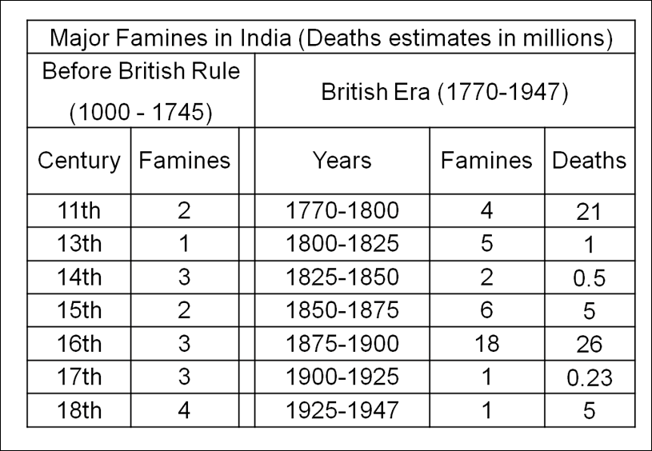
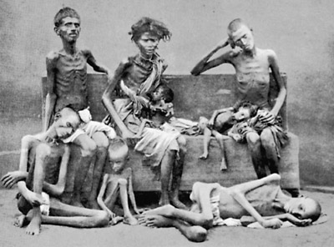

Slide 27
The famine of 1770 occurred in 1769 and 1770. It is popularly known as Chhiyattarer Manvantar or the Great Famine of 1176. It was the worst famine in Bengal in the 18th century. The excessive rainfall in 1770 did not relieve the people from the sufferings of drought of the year before; on the contrary, it caused overflowing of rivers and damaged standing crops. The existing revenue system of land and activities of middlemen in the food grain market further deteriorated the situation.
The East India Company administration put the whole blame for the famine on the vagary of nature. But a quite different picture is also evident from some other facts. The revenue collection of East India company before and during the famine years gives a clear picture of exploitation.

Slide 28
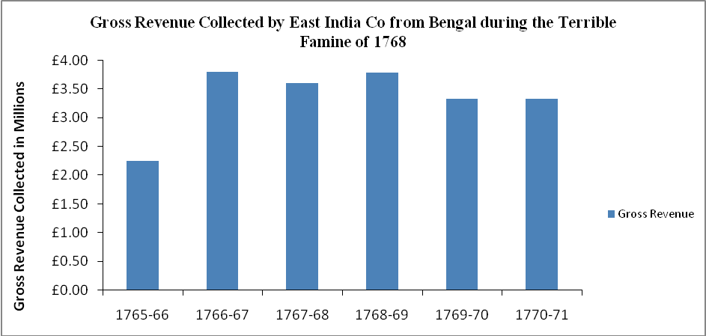

Slide 29
The famine of 1866 Although Orissa was the main disaster zone, part of Bengal was also affected. Famine affected areas experienced a sharp decline in real wages of agricultural laborers. For the first time, an official body with extensive power of inquiry named the 'Famine Commission' was formed to investigate the causes of this famine and to suggest remedial measures.
The famine of 1896-98 affected Bengal along with provinces such as Bihar, Bombay, Oudh, Central Provinces and Punjab. In Bengal the failure of rainfall was the triggering factor. Food grains were available in market, but these were beyond the reach of the majority who had virtually no purchasing power. No market intervention by the government was in evidence to control prices.

Slide 30
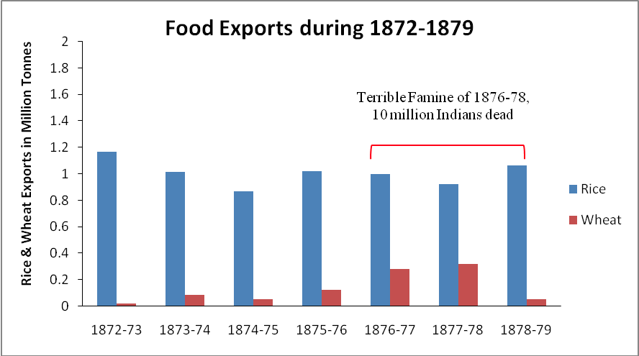

Slide 31
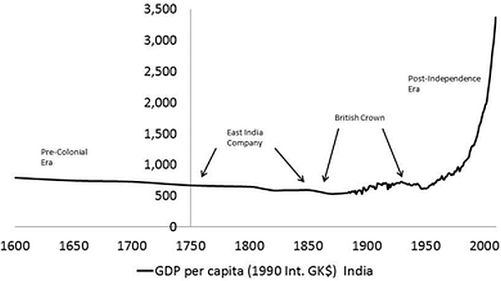

Slide 32
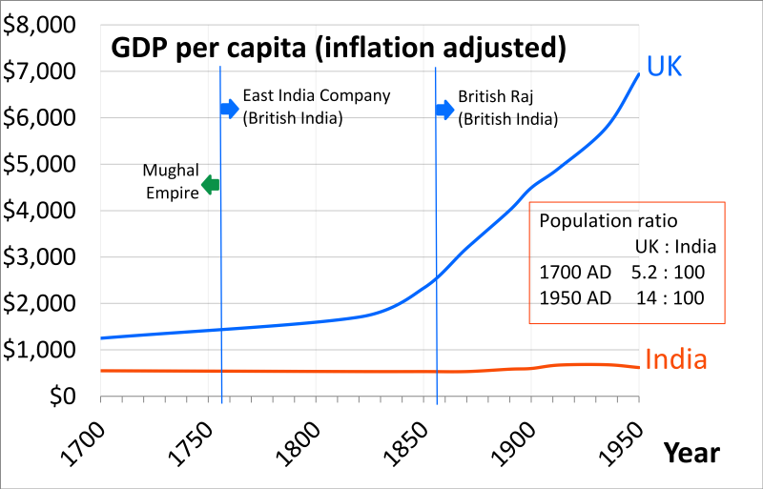

Slide 33
The Great Bengal Famine of 1943 was one of the worst famines to have struck this region. A series of crop failures beginning from 1938 and other disruptive events accompanying the Second World War precipitated this famine. Interruption of normal imports of food grains from Burma due to its fall to the Japanese, dislocation of trade, irregular movement of food grains due to the war in the East, and building up of provincial and district barriers against the movement of grains and other essential supplies, increased demand for food to meet the want of the army, and inflow of refugees were some important factors leading to the famine of 1943. And the failure on the part of the administration to foresee these crises at the beginning of the war added further fuel to the fire.

Slide 34
A heavy toll of life was claimed by the famine. The total number of deaths was estimated at 3.5 million. Almost the whole of Bengal was more or less affected by the famine and suffered loss of lives. But it is noteworthy that though a large number of people died from starvation on the pavements of Calcutta, not a single person among the dead belonged to the city and its suburbs. People migrated to the city from outside in search of food, which most of them often did not find, and many among them died implying that people from rural areas were more vulnerable to the disaster.

Slide 35
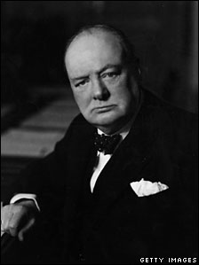
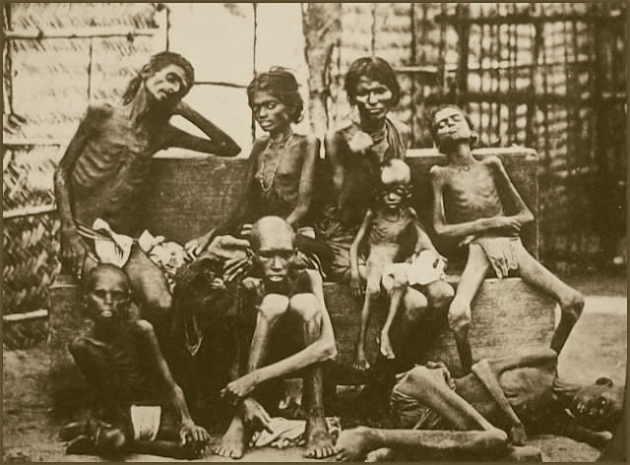
"I hate Indians," he told the Secretary of State for India, Leopold Amery. "They are a beastly people with a beastly religion." The famine was their own fault, he declared at a war-cabinet meeting, for "breeding like rabbits."
Winston Churchill

